Slide 1


Domino’s Pizza Sales
By Prasanna Bhatkhande

Slide 2
CONTENTS
This project focuses on analyzing pizza sales
data using SQL to answer various business
questions. The primary objective is to gain
insights into sales performance, customer
preferences, and inventory management to
drive decision-making for a Domino’s pizza

Slide 3
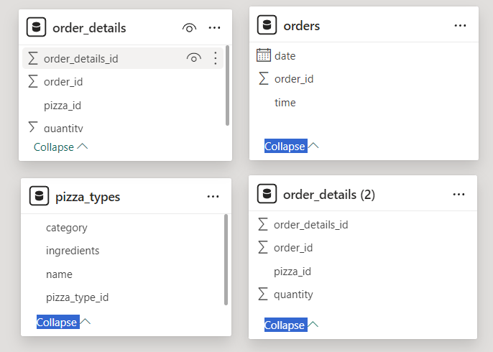
Dataset Of Domino’s pizza sales

Slide 4
Questions :-
1 . Retrieve the total number of orders placed.
2. Calculate the total revenue generated from pizza sales.
3. Identify the highest-priced pizza.
4. Identify the most common pizza size ordered.
5. List the top 5 most ordered pizza types along with their quantities.
6. Join the necessary tables to find the total quantity of each pizza category ordered.
7. Determine the distribution of orders by hour of the day.
8. Join relevant tables to find the category-wise distribution of pizzas.
9. Group the orders by date and calculate the average number of pizzas ordered per day.
10. Determine the top 3 most ordered pizza types based on revenue.
11. Calculate the percentage contribution of each pizza type to total revenue.
12. Analyze the cumulative revenue generated over time.
13. Determine the top 3 most ordered pizza types based on revenue for each pizza category.

Slide 5
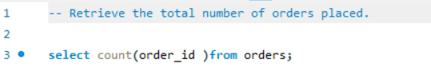
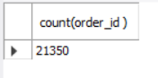
1 . Retrieve the total number of orders placed.
Input :
Output :

Slide 6
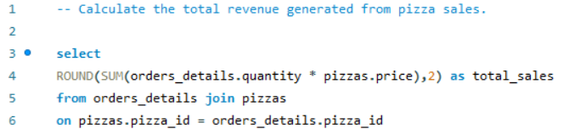
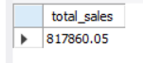
2. Calculate the total revenue generated from pizza sales.
Input :
Output :

Slide 7
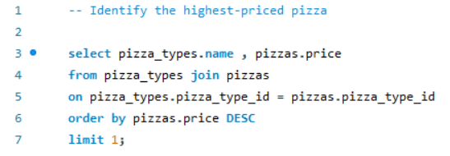
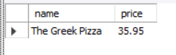
3. Identify the highest-priced pizza.
Input :
Output :

Slide 8
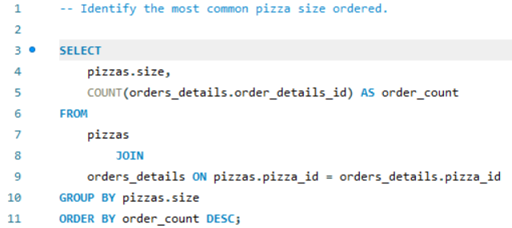
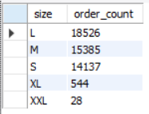
4. Identify the most common pizza size ordered.
Input :
Output :

Slide 9
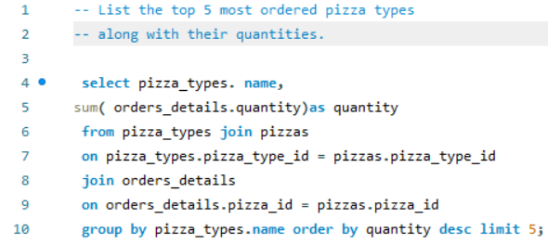
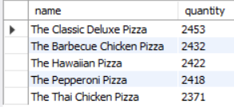
5. List the top 5 most ordered pizza types along with their quantities.
Input :
Output :

Slide 10
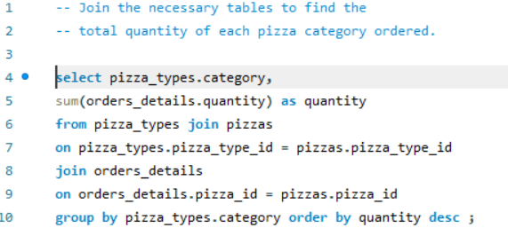
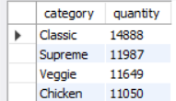
6. Join the necessary tables to find the total quantity of each pizza category ordered.
Input :
Output :

Slide 11
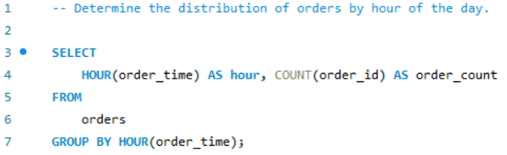
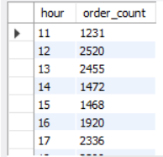
7. Determine the distribution of orders by hour of the day.
Input :
Output :

Slide 12
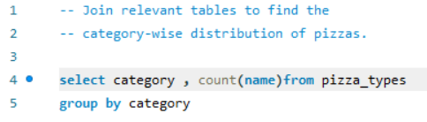
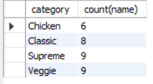
8. Join relevant tables to find the category-wise distribution of pizzas.
Input :
Output :

Slide 13
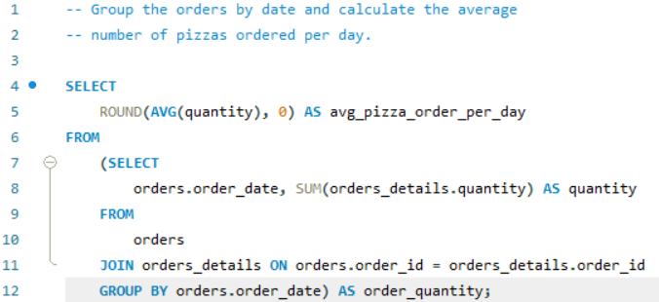
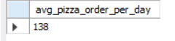
9. Group the orders by date and calculate the average number of pizzas ordered per day.
Input :
Output :

Slide 14
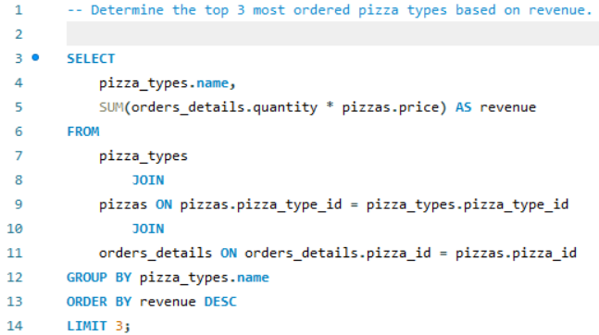
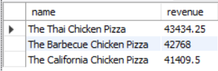
10. Determine the top 3 most ordered pizza types based on revenue.
Input :
Output :

Slide 15
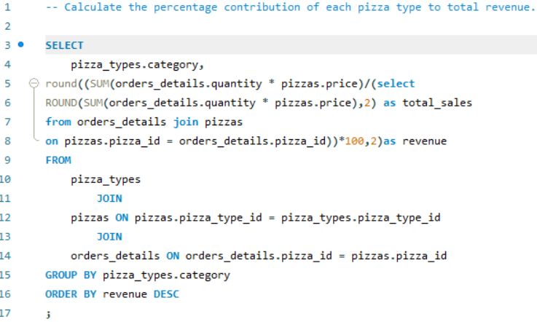
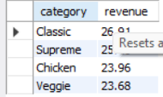
11. Calculate the percentage contribution of each pizza type to total revenue.
Input :
Output :

Slide 16
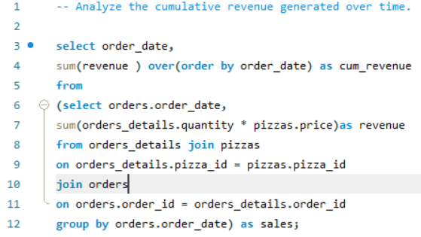
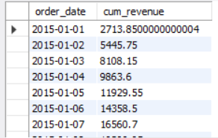
12. Analyze the cumulative revenue generated over time.
Input :
Output :

Slide 17
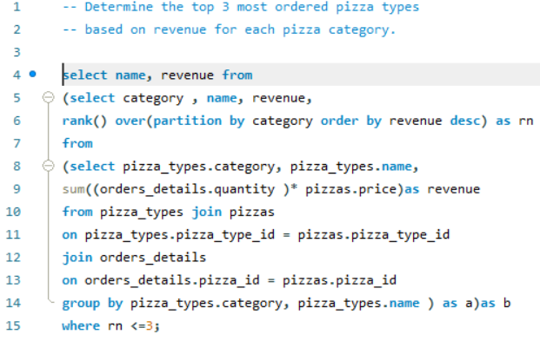
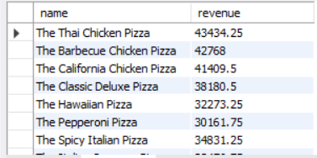
13. Determine the top 3 most ordered pizza types based on revenue for each pizza category.
Output :
Input :

Slide 18
THANK YOU

